Slide 1
Data Management Planning for grant writing: Arts & Social Sciences and Law
Library Research Support

Slide 2
What is research data?
Information either created or used as an integral part of research.
Can be born digital or digitised
Data underpins research claims.
May have high re-use value for other researchers.
Notes:
Research data is simply the evidence you have collected or created to underpin your research, and to validate your research claims. You might have created it, scanned it, measured it, photographed, or recorded it, or read and compiled it.
It doesn't include consent forms, websites, project reports, or the administrative data generated during running the project.
It may have value to other researchers because it would be time consuming, costly or impossible to recreate. Even researchers in other disciplines may find the data useful.

Slide 3
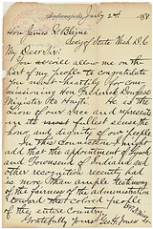
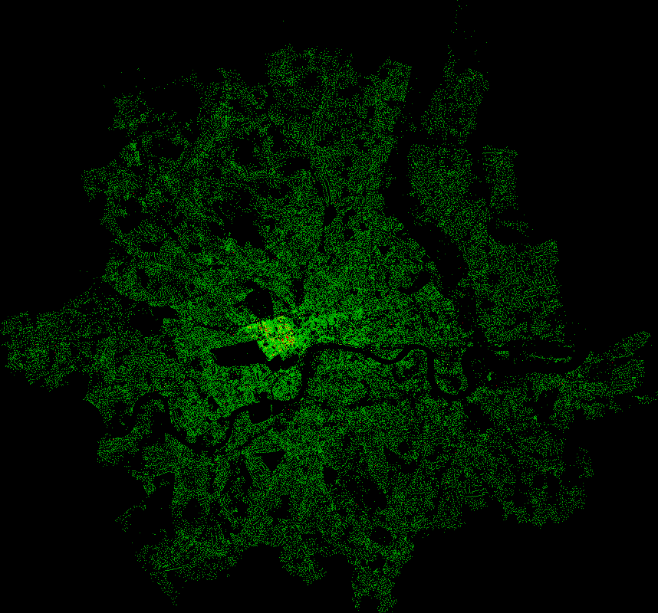
Documents (text, MS Word)
An interview transcript
Diaries
Digital photographs or video
Spreadsheets
Online survey results
Audio recordings
Zoom recordings of interviews
Notes:
These are some of the types of data you may generate in Arts, Social Sciences and Law. It ranges from scans and photographs of artifacts and texts, through transcriptions of manuscripts and texts, to audio recording and online interviews, including recorded video.

Slide 4
General principles
In addition to ‘research uutputs’ (e.g. journal articles/exhibitions/book chapters), ‘research data’ often has value too
Research data should be preserved and shared
Sharing is beneficial to data owners/creators (recognition via data citation, or increased likelihood of future funding)
Notes:
Research data is an output in its own right, and in its own way, it is as valuable as a journal article, a book chapter or an exhibition. Many funders expect you to store and share your data, so others can access it, but the wider message of Open Research is that sharing data is for the public good, to accelerate our understanding of the world and particularly when research is publicly funded, it means better value for money for the funder and the public.

Slide 5
Research data & grant writing
90% of top funders now mandate research data management
Most ask for a Data Management Plan (DMP) at application which covers: data creation, organisation, documentation, storage, preservation & sharing plans
AHRC and ESRC now ask for a Data Management Plan
Notes:
The vast majority of funders (and all the big ones) now require a Data Management Plan, usually at the application stage. The plan covers the following:
What data you will create:
'bundles' of data types, e.g. 200 x interviews, 500x archive references, 100 stills of an exhibition, 3x video of focus groups, so the funder knows you have thought out all of the separate strands of data which will be generated
file types – e.g. .docx, .pdf, .xlsx, .jpeg, .tiff and any specific proprietary software file types, so you can roughly estimate the size of each 'bundle'
Estimated size of the data generated during the project, so the funder knows this has been budgeted for
How you will organise it:
File naming conventions and routines for saving data
Who will be responsible for day to day management of the data
Quality control processes
What documentation you will need to understand and replicate or reproduce it:
Additional documentation, protocols, readme.txt files,
documents describing the process for collecting data, parameters/inclusions/exclusions in the dataset, and why these decisions were made
Use of any metadata standards
How you will store it in the short and long term:
What data will be collected on, and how will it be backed up
When it will be moved to secure networked file storage, such as the RDSF
Particularly important when working remotely or in the field
How you will preserve it and share it;
which repository/repositories, any code repositories, if you have code
any sensitivities which will mean there are access restrictions on who you can share it with (will it be open, or require some sort of registration before accessing it)
how long you will keep exclusive use of the data after the project ends.

Slide 6
AHRC Data Management Plan
Came into force on 29th March 2018 (only a Technical Plan previously)
Required at application stage for all Research Grants, Follow-on Funding and Leadership Fellows proposals (2 pages maximum)
Outline types of data that will be created, proposed methodologies, storage arrangements and any ethical and legal issues
AHRC expect data to be available for at least three years after the end of the project
Published articles to include a 'Data Access Statement' stating where the data can be accessed and under what conditions
Notes:
SInce 2018, the AHRC has changed from Techical Plans to 2 page Data Management Plans. They provide a template, and it is required for Leadership Fellows, Research Grants and Follow on Funding applications.
The plan has specific questions about how projects will manage data.
Data types and why you decided to use them
Proposed methodologies used to create the data, including how personnel and the University will be suitable to support the data/digital aspects of the work
Data storage and back up procedures in the short and long term, including how long it will be stored for and any costs incurred
How you will share it and its value to others, including how it could be used in the future, when you will be releasing it, whether there will be a cost to access it, and how different audiences will be informed
Any ethical and Legal considerations when collecting, storing and releasing the data
AHRC do expect data to be availble for a minumum of 3 years post project

Slide 7
ESRC Data Management Plan
Strongly advocate further reuse of data, but recognise some research data are more sensitive than others
Require a Data Management Plan at application (max 3 pages)
Information on new data, quality assurance and data security
Data sharing and any expected difficulties e.g. consent, ethical issues
Data must be made available for re-use or offered to the UKDS within three months of the end of the grant (or final payment may be withheld)
Published articles to include a 'Data Access Statement' stating where the data can be accessed and under what conditions
Notes:
The ESRC also requires a detailed Data Management plan, with a similar template to AHRC. It covers
An assessment of existing data, including use of third party datasets and if new data is to be created, the gap identified. ESRC encourages the re-use of existing data
Information about new data, including the methodologies for collection, the amount, type, documentation, metadata standards and formats of data
The quality assurance of data, including data entry, transcripotion and peer review of the data
Data security and back up procedures
Curation of data and day to day management, including how data will be organised and documented so it is easily understood by others
Any difficulties in data sharing, for example, strategies for dealing with informed consent, anonymisation and restricting access to data, and explicit procedures which will allow the data to be made available for future research
Copyright or IP ownership
Overall responsibilities for data management and preparation for data sharing.
Data must be available for re-use or offered to the UK Data Service within three months of the end of the grant or the final payment may be withheld.

Slide 8
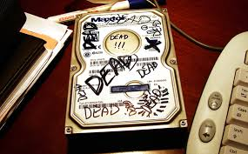
Storing data
Never store valuable/sensitive data on USB drives, Dropbox, MyFiles or any single PC’s hard drive
UoB provide the Research Data Storage Facility (RDSF*). 5TB free per PI, can be shared with collaborators
Other secure storage is fine (e.g. NHS servers, suitable departmental store)
* www.bristol.ac.uk/acrc/research-data-storage-facility/
Notes:
When writing your DMP, one of the first things to consider is where you will store your data.
Above all, remember to never store your data, especially if it is valuable or sensitive, on USB drives, Dropbox, MyFiles or any single PC's hard drive.
The University has a specific, safe and secure Research Data Storage Facility, which is backed up nightly to tape, with data stored in 2 secure locations. University PIs are entitled to up to 5TB of storage space, split across their projects. More space is available on disk or tape, at a cost (this will need to be factored into your costings). This storage space also gives you access to the University's Research Data Repository, for publishing (more on that later).
You can give external collaborators access to data at a file level on the RDSF, and you can access it remotely, using the VPN.
Departmental level storage is fine eg. BRMS, NHS servers, but OneDrive is only suitable for very short term/transient research data, and is not suitable for medium to long term storage.
We've got more resources on Storing and working with data on our webpage.

Slide 9
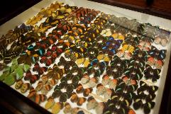
Organising data
Include how files & folders will be named
How versions will be controlled
If producing traditional databases, what the columns and row labels are
See FAIRsharing.org for standards, databases, policies used in your fields
The Research Data Service runs Data Management Training courses, and has a bootcamp and guidance documents on the webpage
Notes:
Decide up front how files and folders will be named, what versioning system you will use for them, how you will file them – your information architecture, and who is responsible for doing this - its day to day management.
Will you store by site? Month? Date? Researcher? This is crucial if you are working collaboratively with others, as then there will be no confusion over what files should be stored where, and who is responsible for overseeing data management. Will there be a lead? Will you share the load equally? Who uploads the final version of a document?
We have an One Minute Guide to file organisation on our webpage on storing data.
If you are creating a database, decide on what the columns and row labels will be before the fields are populated.
FAIRsharing.org provides details on standards – controlled vocabularies, databases, and any associated policies from funders, publishers and repositories.
We have lots of training available we are happy to run these at Faculty, School or Department level, and can also provide bespoke training for research groups. We have an introductory Bootcamp for Research Data Management.

Slide 10
Costing
Larger funders will cover justifiable data management and sharing costs
Normally have to be costs incurred during the project period
Open Access: check the Open Access Funding¹ page for more information or email lib-research-support@bristol.ac.uk
¹www.bristol.ac.uk/staff/researchers/open-access/funding/
Notes:
When costing your project, these are the things to bear in mind.
UKRI funders will cover reasonable costs, including additional storage, paying for repository costs, factoring in time for specialists to anonymise and transcribe your data, and for a data manager if the project requires I.e. if it will generate large volumes of data or complex datasets.
If you publish using the University's Research Data Repository, there is no charge to share your data, but some repositories will charge for publication, based on the size of the deposit.
Please do factor in costs for transcription and anonymisation, as you may find you do not have the time to do this, and if participants consented to sharing anonymous/deidentified data, you will be unable to share it at the end of your project. The University has confidentiality contracts with a few professional transcriptions service, if you need additional costing advice. http://www.bris.ac.uk/infosec/uobdata/transcription/

Slide 11
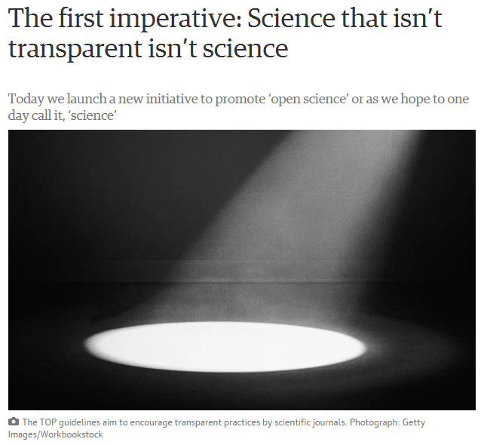
Research data & publishing
Many publishers require research data to be made available & a data access statement included in the article, e.g. Nature, Royal Society, Elsevier & Public Library of Science.
Notes:
The other point in the research lifecycle where you may find there is a requirement to share data is when you come to publish an article. Many publishers now require a dataset DOI for articles at the proofs stage, so it can be added in a template, or in a data access statement. A data access statement details where research data can be accessed and under what conditions, and many funders also require this in published articles, so it is important to remember to practise good research data management throughout your project and to expect your data to be shared at the time research outputs are published.

Slide 12
Open Access Costs
Funders usually require work to be made Open Access
Gold (Paid) Open Access
Approx £2200 per article
UKRI and Wellcome Trust provide block grants to the university for Journal Articles
Otherwise, check with funder to see if these costs should be included in application
Green (Self Archiving) Open Access
Free
Upload the Accepted Manuscript to Pure
Some journals do not have a Green Option - use Gold OA or avoid
Any questions, email lib-research-support@bristol.ac.uk
Notes:
Most funders will have a policy requiring Open Access.
There are two types of Open Access, some journals will offer both, but increasingly it will be one or the other. Both are acceptable to funders.
Gold OA costs money (about £2000), but means the final manuscript will be open access on the publishers webpages.
- Good for high profile papers.
- UKRI funders and Wellcome Trust have provided block grants to the university to pay for these. Authors with these funders should not put journal OA costs in their applications.
- Other funders will have their own rules. Authors should check with them.
Green OA is free, and can be achieved by uploading the Author's Accepted Manuscript to an institutional repository (At Bristol it's done via Pure).
- Some journals only allow Gold OA so check your major journals beforehand.
The Library Research Support team are happy to help. Email lib-research-support@bristol.ac.uk.

Slide 13
Sharing data
Sharing data with human participants can be challenging
Consent, consent, consent (to SHARE)
If data will be unavailable after study for ethical reasons, say so in DMP
Use a Research Data Repository – eg. UKDS or our own Research Data Repository
data.bris retains data for minimum 20 years
provides a stable, citable ‘data DOI’
offers multiple access control options - (Open, or Restricted/Controlled for bona fide researchers only, subject to registration and approval)
Notes:
Sharing data can with human participants can be be problematic because of sensitivities with anonymity and reidentification however, these are not insurmountable.
Make sure that there is a line in your consent and participant information sheets which clearly states consent to share is being asked for -
'I consent for my data/anonymised data/data stripped of identifiers to be shared openly/with other researchers subject to a data access agreement'.
If you don't have this in your consent forms, there may be issues when you come to share your data, and it will delay or prevent publication. We have some suggested wording in this document Sharing research data concerning human participants, but please do email us to check.
If you can't share the data for ethical reasons, please state this explicitly in your DMP. Many publishers now expect researchers to share underlying data at the point of publishing a paper, so you need to be able to justify the reason why you are unable to do so, and this is a good way to document it.
When you go to share, share it via a data repository, who will provide you with a permanent identifier, often a DOI, which you can link to in your published works, and link from in your dataset record.
You may have a discipline specific repository for data, for example the UK Data Service also https://www.re3data.org/ has a searchable database of repositories.
You can share the data through the University's Research Data Repository, data.bris, where you can share openly or with access controls which limit data access to researchers only, subject to application. Alternatively, you may also use a commercial repository, such as Figshare, Dryad or Zenodo
'On request' is not acceptable to funders – potential data users may be unable to contact researchers as they may have moved institutions, researchers may not have brought data with them, they could have lost the only copy, and they may even be selective about who they share the data with. From a funder's perspective, this is not an appropriate way to preserve the data long term, to make it visible or to share the data widely to maximise returns from public funding.

Slide 14
Key points when planning data management
Use open file formats, especially for sharing and preserving data
Organise data sensibly and provide documentation
Always have at least two copies of data
Use robust networked storage for long-term preservation
Use a repository to share data and obtain a DOI
Consider potential difficulties in sharing and try to overcome these, e.g. appropriate consent, embargoes, copyright issues
Notes:
There are a few key points to remember when planning data management, and these relate to collecting, organising, storing and sharing data
- Use open file formats wherever possible - some data may be generated in one file format for working, but converted to an open and/or less data intensive format for preservation and sharing
- Think carefully about how you will organise your data before you start to collect it – think about the information architecture and folder structure, who will be be able to access and be responsible for adding to and backing up folders before you start
- Always have at least two copies of the data, stored separately. Ideally, you should back up working data whenever changes are made, to a secure filestore and the RDSF, as these offer more security and robust storage
- Share data via a designated data repository, with a DOI
- Explicitly ask your research participants for consent to share – either openly or via controlled access, and consider any copyright issues or potential embargos before data collection begins.

Slide 15
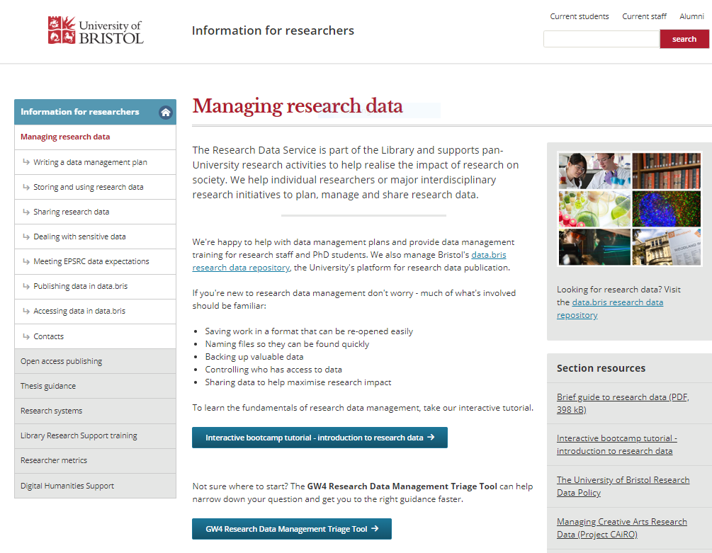
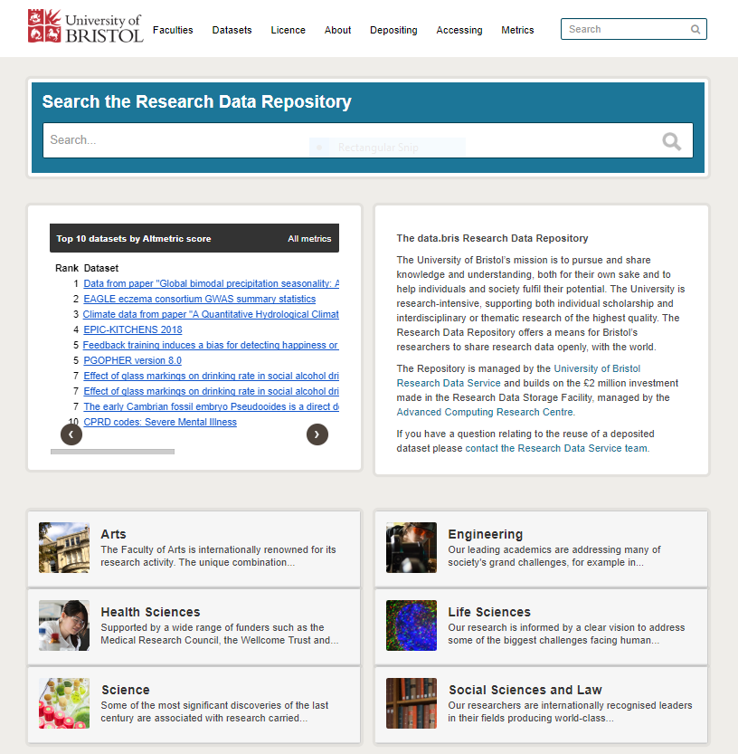
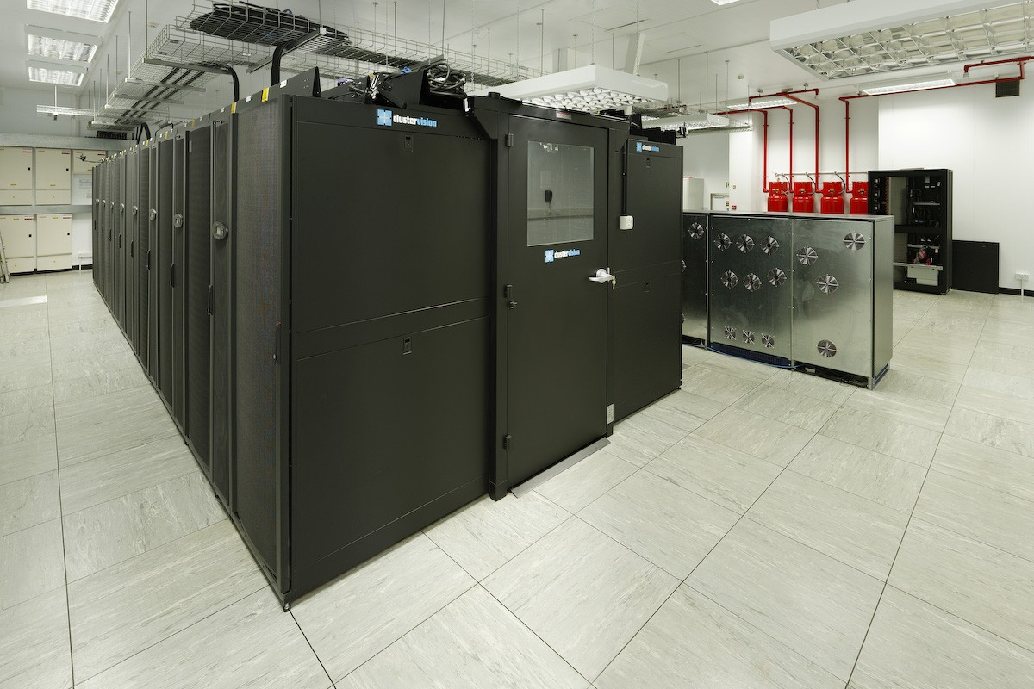
University of Bristol Research Data support
Research Data Service: helpdesk, advice, training, DMP checking (http://bristol.ac.uk/staff/researchers/data/, data-bris@bristol.ac.uk)
Research Data Repository: data publication platform; for sharing open, controlled and restricted data https://data.bris.ac.uk/data/, data-bris@bristol.ac.uk)
Research Data Storage Facility (RDSF): data storage for your project data; for PI’s, project team, and external collaborators (www.acrc.bris.ac.uk/acrc, hpc-help@bristol.ac.uk )
Notes:
If you need more help about research data management, here are our webpages.
For general help with Research Data Management, training, DMP checking and sharing data, please email us at data-bris@bristol.ac.uk
For data storage and setting up an Research Data Storage Facility account, please contact hpc-help@bristol.ac.uk

